Slide 1

Functional Programming
Pranali Bose

Slide 2
Agenda
Basics of Functions
Python Comprehensions
Lambda Function
Functional Programming
Common I/O Error

Slide 3
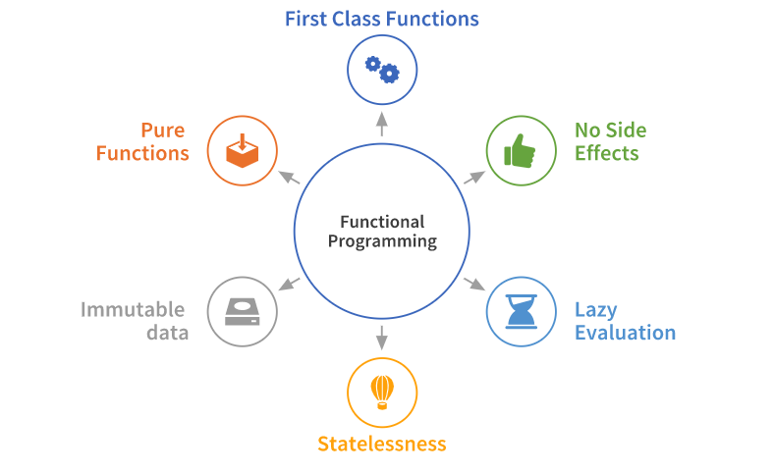
Functional Programming

Slide 4
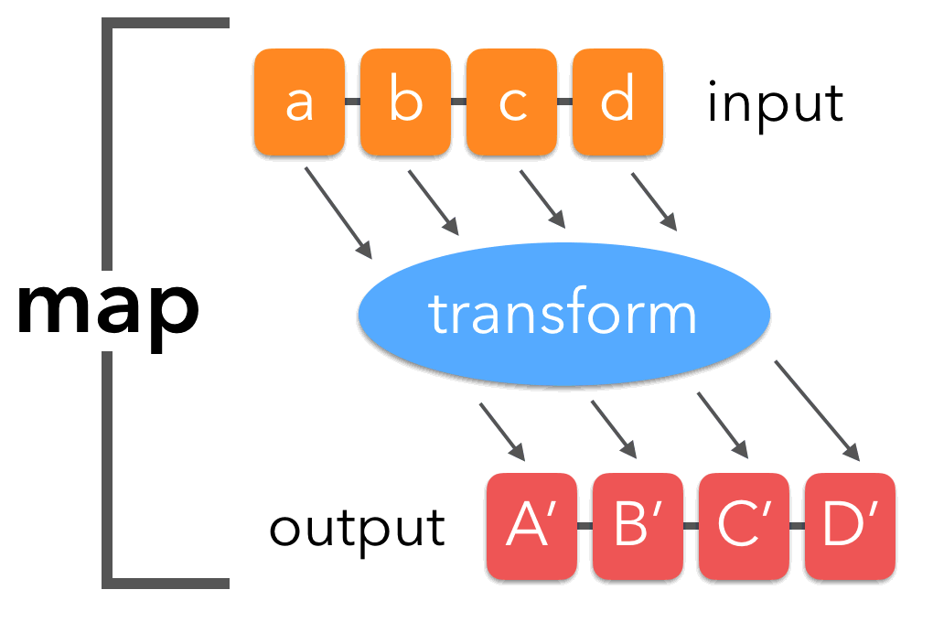
map()

Slide 5
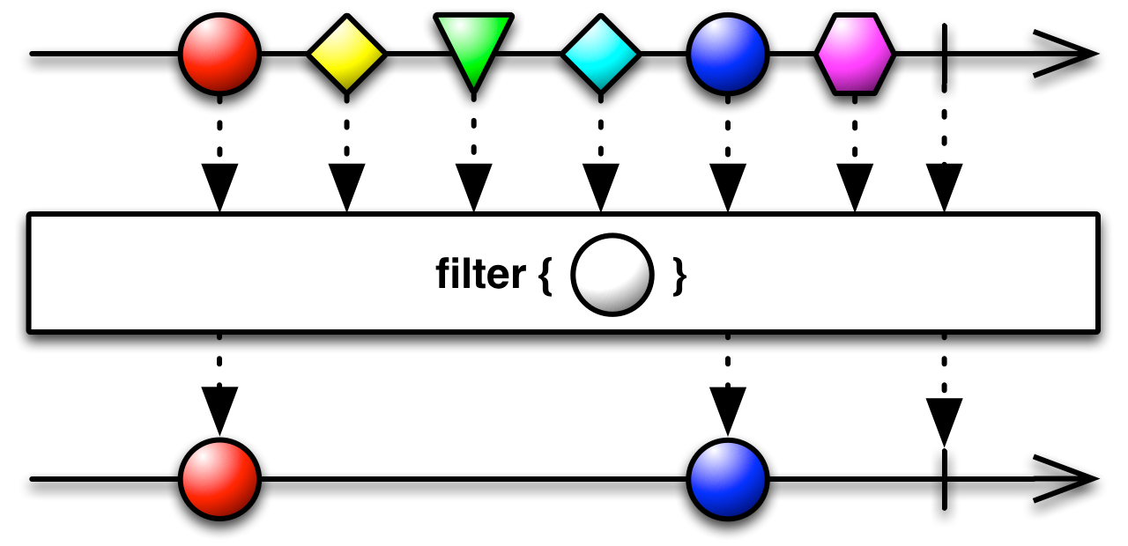
filter()

Slide 6
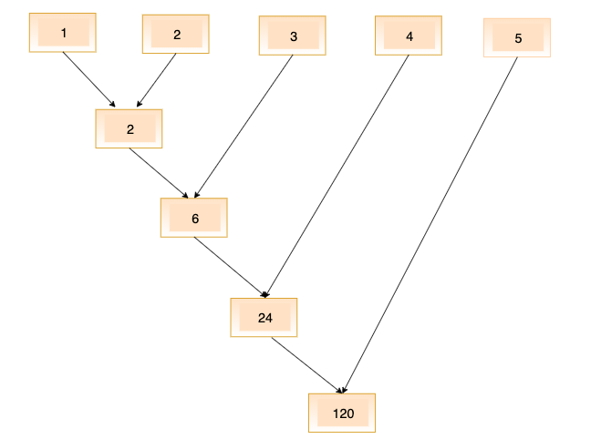
reduce()

